Slide 1
Predictive control 8 Numerical examples of prediction with CARIMA models
Anthony Rossiter

Slide 2
Introduction
The previous video showed how one could form a prediction based on a CARIMA model.
The presentation was purely algebraic.
This video uses a few simple numerical examples to demonstrate how one can form these prediction equations in practice.
The author recommends the use of software such as MATLAB for the number crunching. It will be seen that code is trivial – far far easier than using Diophantine methods!

Slide 3
Model and output predictions
The previous video developed the following results.

Slide 4
Example 1
Using the definition of the prediction matrices and a horizon of 4.
Use MATLAB for this part – 2 slides time

Slide 5
Comments
The reader will notice immediately that these are not paper and pen exercises, so the key skill is to create effective code to form the required matrices.
As the Toeplitz matrix C_{A}, is lower diagonal, it is well conditioned for inversion and could be performed very fast. Therefore one need not worry about such issues.
Similarly, if one were really bothered about computational load, it is clear that many of the implied multiplications to find H, P, Q are common and thus an efficient computation is possible.

Slide 6
Observations
An interested viewer may like to prove that:
A simple example can illustrate this.
Easy to confirm on MATLAB – left to the viewer.

Slide 7
Numerical examples
We will switch to MATLAB to demonstrate how simple the code is for forming prediction matrices.
We include a MIMO example for completeness – most of the code is simply defining the model parameters but the prediction part is identical!

Slide 8
Summary
It is common to use discrete models for prediction.
This video has shown how CARIMA models can be used to form n-step ahead predictions.
In particular it is shown that the software to development the prediction matrices is trivial – literally just a few lines!
The author would recommend avoiding diophantine approaches to predictions as these are somewhat obscure, more cumbersome and no more efficient.

Slide 9



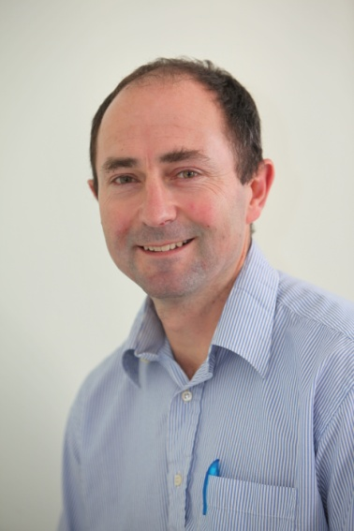
Anthony Rossiter
Department of Automatic Control and Systems Engineering
University of Sheffield
www.shef.ac.uk/acse
© 2014 University of Sheffield
This work is licensed under the Creative Commons Attribution 2.0 UK: England & Wales Licence. To view a copy of this licence, visit http://creativecommons.org/licenses/by/2.0/uk/ or send a letter to: Creative Commons, 171 Second Street, Suite 300, San Francisco, California 94105, USA.
It should be noted that some of the materials contained within this resource are subject to third party rights and any copyright notices must remain with these materials in the event of reuse or repurposing.
If there are third party images within the resource please do not remove or alter any of the copyright notices or website details shown below the image.
(Please list details of the third party rights contained within this work.
If you include your institutions logo on the cover please include reference to the fact that it is a trade mark and all copyright in that image is reserved.)

